Slide 1






Project expo’25
Startup
consultancy
Ankit sharma
Carol furtado

Slide 2



agenda
Introduction
Methodology
Survey- Insights
Result & Analysis
Case study

Slide 3
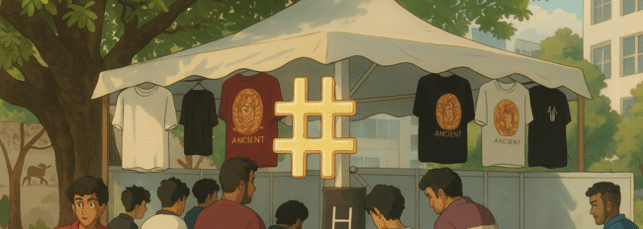



introduction
In the dynamic fashion industry, understanding consumer preferences is vital. This project analyzes T-shirt trend survey data—covering fabric, color, price sensitivity, and brand loyalty—using Power BI for visualization. The insights aim to help fashion brands align designs with customer expectations, refine marketing strategies, and enhance satisfaction to remain competitive.

Slide 4





methodology
Data collection
Data cleaning & preparation
Data visualization & analysis
Insights & report generation

Slide 5



deciding factor for purchase
Quality of material > Design > Price
Brand should focus on high-quality material and eye-catching design to attract customers.
Pricing strategies should reflect the perceived value of the product.

Slide 6
Preferred sopping place
Online store > department store > vendor/market place
There is a growing shift toward digital shopping and structured retail environment over traditional markets.

Slide 7
Brand discovery method
social media ads > In store discovery > Online search engines > word of mouth > influencer endorsements
Social media ads are the most common way people discover new t-shirt brand, showing the strength of digital marketing.

Slide 8



result
Choice factor
Quality of materials>Design comes >price factor
Preferred shopping place
Online stores >Department stores > Vendor /market place
Brand discovery method
Social media >Online website > Word of mouth >Influencer endorsement.

Slide 9
Case study
Hash t-shirt sales at incident

Slide 10

Case study
Hash t-shirt sales at incident

Slide 11



Challenging Price Perception at NITK
Common Belief
Higher prices lead to lower sales—an assumption
widely accepted, including at NITK.
Experiment Conducted
Products were categorized based on
design, price, And customer demand
to analyze actual market trends.
The experiment challenged conventional pricing wisdom, revealing surprising consumer behavior patterns that contradicted standard assumptions about price sensitivity in the college market.

Slide 12
Key Findings on Pricing Strategy

Slide 13
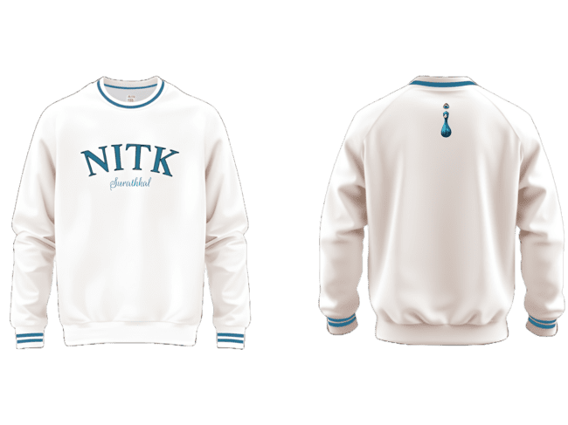
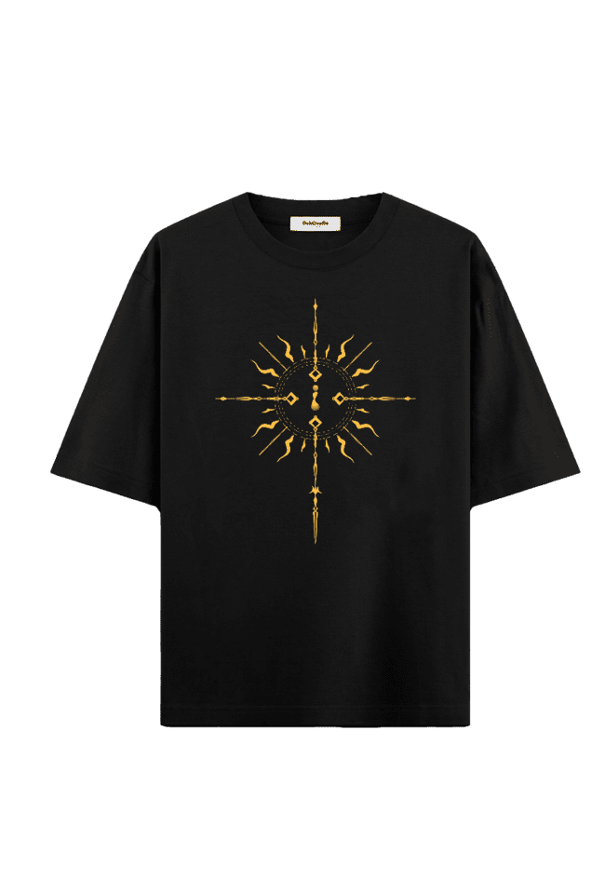
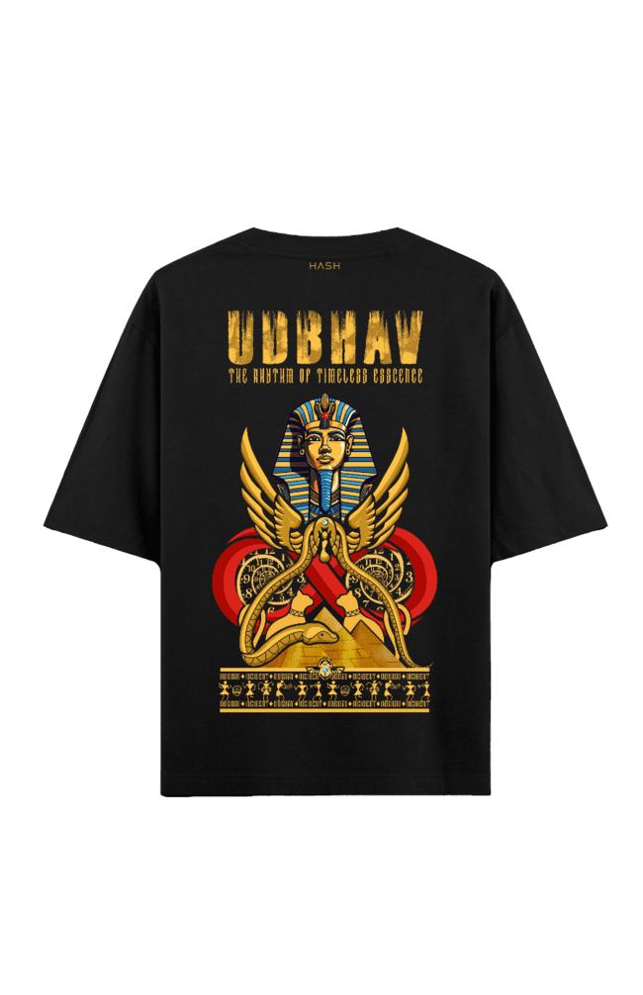
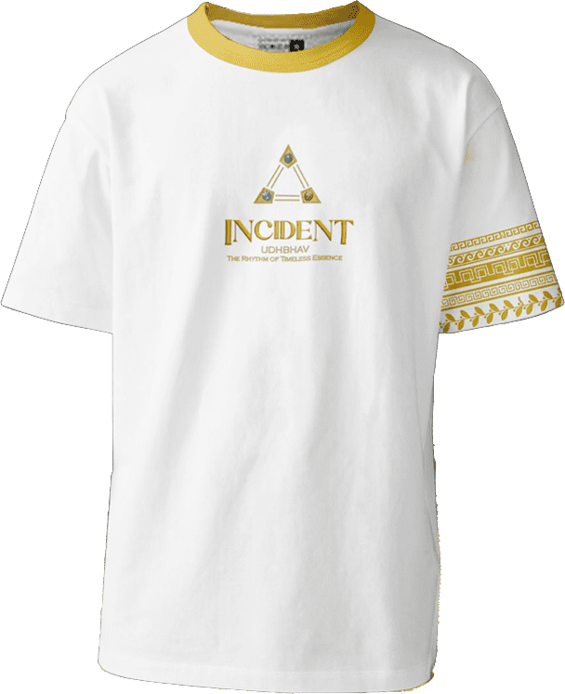
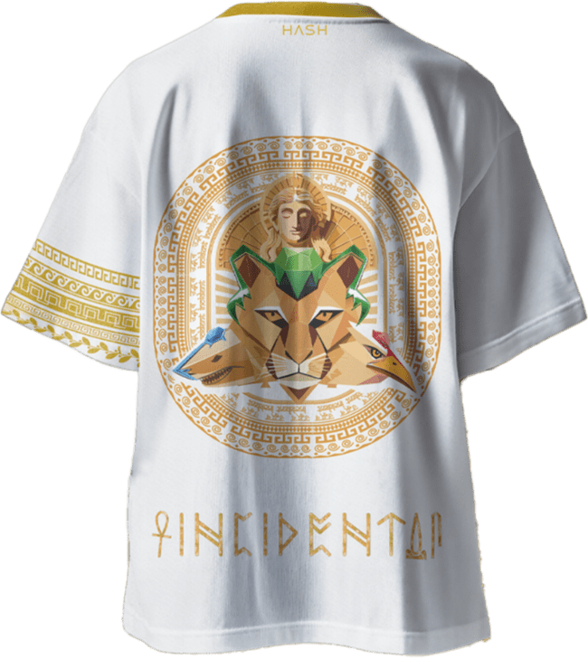
Key Findings on Pricing Strategy
Highest-Priced Product
Price vs. Perceived Value

Slide 14

Key Findings on Pricing Strategy
Highest-Priced Product Success the costliest product became the second highest-selling, contradicting the usual assumption.

Slide 15
Key Findings on Pricing Strategy
Highest-Priced Product
Price vs. Perceived Value

Slide 16
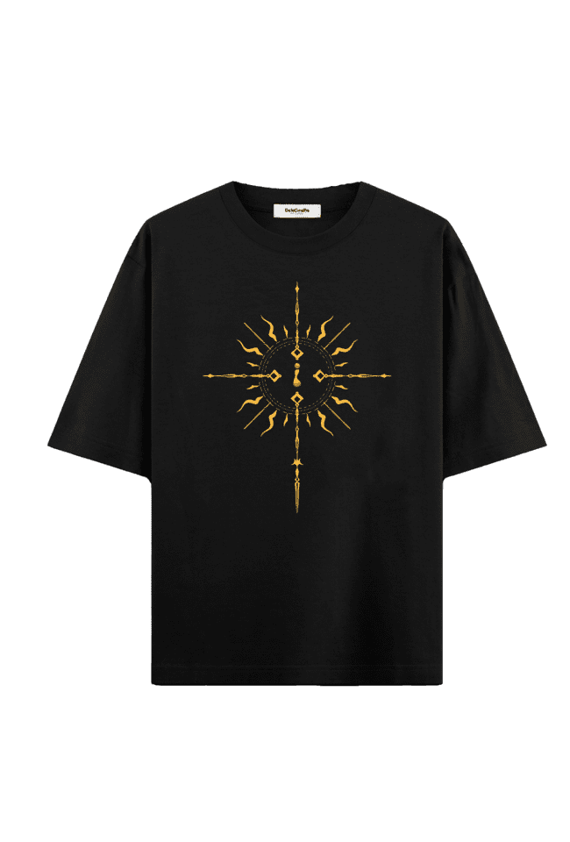

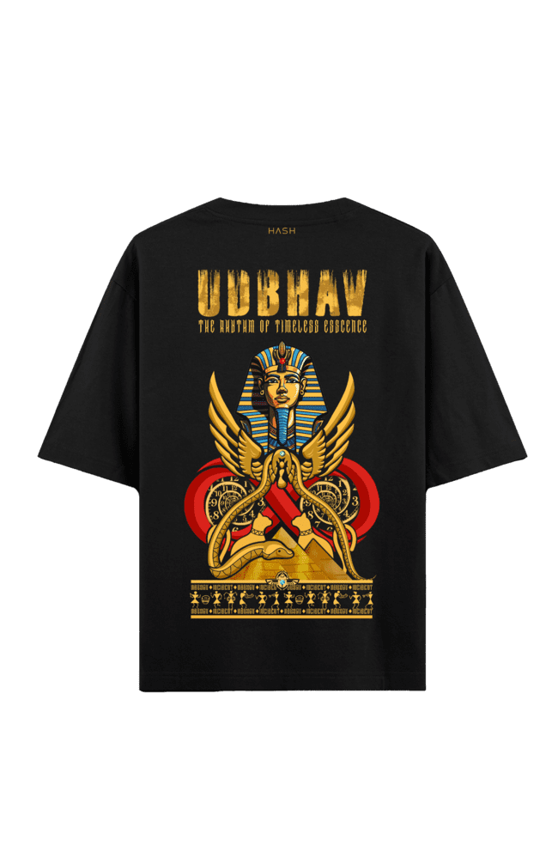
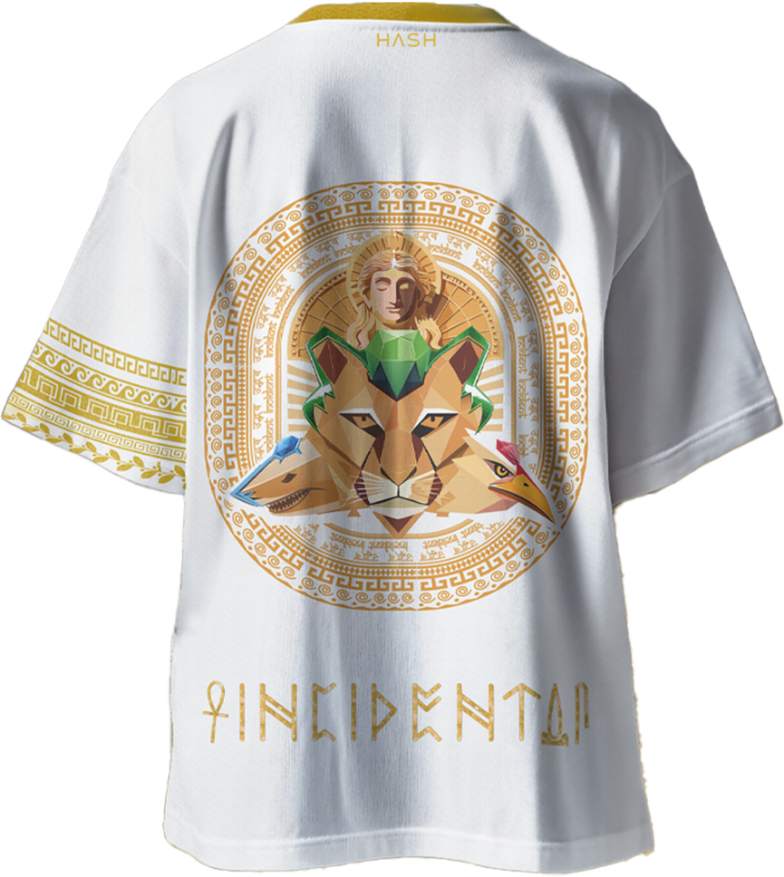
Key Findings on Pricing Strategy
Price vs. Perceived Value Two identical T-shirts (same fabric, different design) were priced ₹70 apart. Surprisingly, the more expensive T-shirt sold 1.5 times more, proving that design and perceived value drive sales more than just cost.

Slide 17
UNDERSTANDING ORDER PATTERNS
DIVERSE AUDIENCE
SPENDING POWER
SALES STRATEGY
Our customer base includes Undergraduate (UG), Postgraduate (PG), and PhD students.
To maximize sales, we should focus more on PG and PhD students while providing affordable options for UG students
UG students have limited budgets and spend less, whereas PG and PhD students place larger orders.

Slide 18


INCREMENT AFTER ANALYSIS
400%
Plot of Year vs No Of Order

Slide 19

Market gap
analysis
Inclusive approach
We analyzed the market, identified gaps, and designed products to fill those gaps.
This year, we expanded our
reach by introducing designs
specifically for girls.
Higher engagement
Profit potential
The response was significantly
higher from both boys and girls
compared to last year.
Covering all segments of
the target market leads to
etter sales and profitability.

Slide 20

Effect of fast fashion
1
500% Drop in Sales
2
Fast Fashion Effect
3
Market Lesson
Depending only on trends is risky. Selling products with long-term demand is better for steady sales.
People buy trendy products, but once the trend is over, they lose interest, leading to unsold stock.
Before the fest, T-shirt sales were high, but after the fest, sales dropped sharply to just 177.

Slide 21

RISE OF ORDERS
SLOW START
Only 7 orders on the first day.
STEADY RISE
Gradual increase in orders over the next few days.
400% INCREASE
Orders spiked fourfold on the final day, reaching 257.
CONCLUSION
This pattern indicates that customers become more active as the deadline nears, leading to a significant rise in orders during the final days.

Slide 22



Thank you!

